Slide 1
Notebooks for Triage and Incident Response: A Tale of DBA Heroism
DataMinds Connect 2020
Oct 13, 2020
Julie Koesmarno
Principal Program Manager
jukoesma@microsoft.com
@MsSQLGirl
Drew Skwiers-Koballa
Program Manager
Drew.SkwiersKoballa@microsoft.com
@SysAdminDrew

Slide 2
Agenda
Notebooks
Triage Fundamentals
DBA Scenarios
End-to-end Incident Response Flow with Notebooks

Slide 3

Azure Data Studio
Cross-platform tool for data-centric and data-adjacent users
Cross-platform for client and server
Windows, macOS, and Linux
SQL Server, Azure SQL, PostgreSQL, and Azure Data Explorer / KQL
Home to Notebooks
http://aka.ms/AzureDataStudio
@AzureDataStudio
Notes:
JULIE

Slide 4




Notebooks Use Cases
Demo: Notebook Basics
Why?
Executable / Interactive
Automatable
Support reproducibility – docs, code, results, explanation
Data Science
Emerging Use Cases
Tutorials
Triage and Incident Response
Data Engineering
Notes:
JULIE

Slide 5
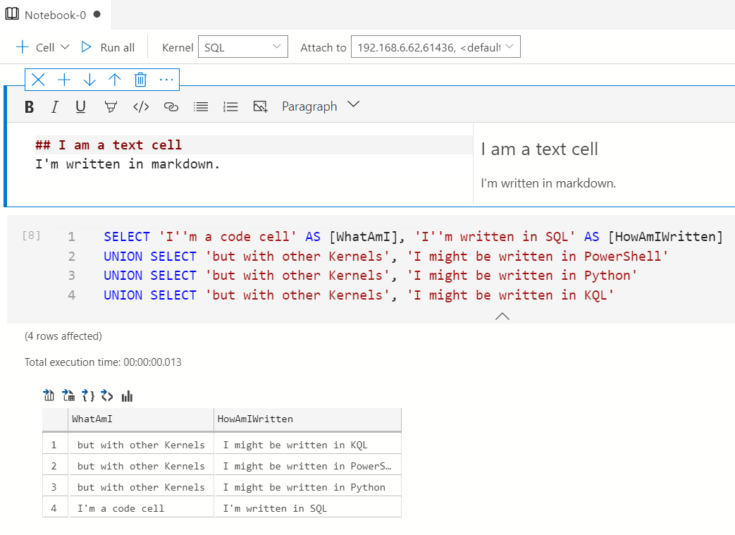
Notebooks
Text cells
Code cells
SQL
PowerShell
Python
KQL
.NET interactive
Notes:
JULIE

Slide 6
This is not:
This is:
Replacing your monitoring solution
Suggesting a monitoring solution
Handing you a 1-size-fits-all DBA solution
Teaching you the foundations of notebooks
Going through some examples to stoke your creativity
Giving you the skills to elevate the benefits of your DBA solution(s)
Notes:
DREW

Slide 7
Triage Fundamentals
What does normal look like?
Narrow your focus
Remediate
Update monitoring and documentation
Notes:
Lifecycle concept – TSG ops ideas

Slide 8
What does “normal” look like?
Capture your baselines
wait statistics
server configuration
Successful triage can be less painful with a little pre-work
Demo: Capturing Baselines
Notes:
DMVs –
Storing baselines in a notebook
Capture perf metrics throughout the incident

Slide 9
Narrow Your Focus
Which of the big 3
Infrastructure
Workload
A query’s execution
Identify the root cause(s)
Demo: Event Logs
Notes:
You may have a different tool to surface the major event logs, but don’t forget to check them before you dive deeper
Leveraging powershell in a notebook to probe different event log sources

Slide 10
Scenario A
Certain queries aren’t completing or are taking a long time
Baseline comparison of DMV shows elevated lock waits and number of deadlocks
Capture results in notebook for incident logs and to collaborate in real time
Focusing on a problem with extended events
Compile specific diagnostic queries into a notebook (helpful for parsing the XML of XEvents)
Demo: Querying DMVs for Specific Information
Demo: Extended Events

Slide 11
Scenario B
The boss’s nephew (intern with sysadmin privileges) just said “oops” from his cube
He was accidentally on a production server when he deleted rows without a where clause
Script remediation steps into notebooks for common incidents
dbatools and PowerShell give us convenient access to backup history
Demo: Backup/Restore

Slide 12
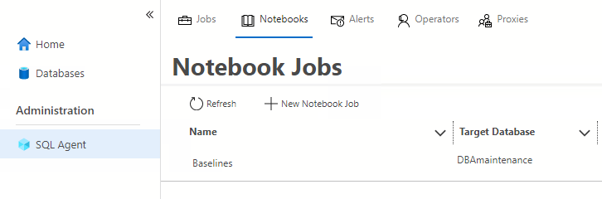
Scenario C
Scheduled notebooks with SQL Agent
Invoke notebooks via PowerShell with SqlServer module
Invoke-PowerShellNotebook
Invoke-SqlNotebook
Demo: Automated Notebooks
Notes:
Invoking a notebook through automation/remotely
Baselines, general diagnostics for monitoring

Slide 13

How does your team measure incident response today?
time to mitigate
number of incidents?
DBA Happiness?
time to respond
Notes:
JULIE

Slide 14

5
Start here …
Adhoc scripts
level
incident response maturity levels
1
Manual documents (OneNote, Word, etc)
2
level
Reusable scripts
level
3
Executable Notebooks
4
level
Automatable notebooks
level
Less 2am calls! Happier DBAs…
5
scalability
maintainability
Notes:
JULIE

Slide 15
Jump start with your existing scripts
Convert SQL scripts to Notebook using ConvertTo-SqlNotebook
Convert Powershell scripts to Notebook using ConvertTo-PowerShellNoteBook https://github.com/dfinke/PowerShellNotebook
4
3
level
level
Reusable scripts
Executable Notebooks
Demo: Convert your scripts!
Notes:
JULIE
Convert SQL to notebooks, Convert PowerShell to Notebooks
Packaging Jupyter Book to Git (one way).
Opening Jupyter Book in ADS. Packaging notebooks as an extension or a remote book
Setting up a reasonable barrier to entry (SQL server agent)
**double check Linux container ability - Drew

Slide 16
Notebook Development and Sharing
Demo: Ship Jupyter Book
Write Notebooks in Azure Data Studio
Troubleshooting Guide template
Bundle and organize your notebooks as Jupyter Books
Use source control – e.g. GitHub, Azure DevOps
Ship it!
For external facing use GitHub release features, example: https://github.com/MsSQLGirl/jubilant-data-wizards/releases/tag/v0.0.0
Ship as an Azure Data Studio extension to launch a Jupyter Book
Integrate with your incident response system
Ensure troubleshooting notebooks are evaluated and fixed during post-mortem
Watch for novel incidents with missing notebooks
New features should be accompanied with troubleshooting notebooks
Notes:
TODO: Julie
Demo: Jupyter book Creation

Slide 17






Incident Response Flow & Ecosystem
System Event / User Reported Incident
Use existing notebooks
Create new notebooks
Add reusable notebook
Rate existing notebooks
Log adhoc notebook in incident system
Update notebook if necessary
Automate
Incident Response System
Investigate & Mitigate
Use Notebook as the incident’s audit trail
Post Mortem
Analyze and enrich Troubleshooting Repo
Troubleshooting Notebook Repo
Notes:
JULIE

Slide 18
Take-aways
http://aka.ms/GetAzureDataStudio
Notebooks for triage and incident response
Triage fundamentals
Incident Response maturity levels
Understand your incident response measurement and goals
End-to-end incident response ecosystem

Slide 19
Additional Resources
https://littlekendra.com/2020/03/19/the-learners-guide-to-sql-server-performance-triage/
https://dbatools.io/
https://beard.media/Notebooks
https://tsql.tech/the-sql-diagnostic-jupyter-book/
https://github.com/SQLvariant/Demos/blob/master/Presentations/Intro-to-Jupyter-Notebooks/8.How-Can-I-Automate-SQL-Notebooks/How-Can-I-Automate-SQL-Notebooks.ipynb
https://github.com/dzsquared/dba-notebooks
http://github.com/mssqlgirl/jubilant-data-wizards

Slide 20
Additional Events
DataWeekender session on Azure Data Studio extension development - https://www.dataweekender.com/schedule
Focus Group @ PASS Summit – follow us on @AzureDataStudio for more info
Notes:
Drew to add more links here, esp for community notebooks

Slide 21
Julie Koesmarno Principal Program Manager jukoesma@microsoft.com
Drew Skwiers-Koballa
Program Manager
drew.skwierskoballa@microsoft.com
Notes:
Thank you for joining us today

